Slide 1

Introduction to Divide and Conquer
An Algorithm Paradigm
By Mohamed Hussein Abo El-Ela
ID: 224175

Slide 2
AGENDA
01
02
03
04
Overview of Divide and Conquer
Exercise
Analytical Analysis
Game

Slide 3
Introduction to Divide and Conquer
Divide and Conquer is a powerful algorithmic paradigm that involves breaking down a problem into smaller, more manageable sub-problems.
The Key idea involves around three steps: Divide, Conquer and Combine

Slide 4
Basic Steps
Divide
Break the problem into smaller, more manageable sub-problems.
Conquer
Solve the sub-problems independently.
Combine
Merge the solutions of sub-problems to obtain the solution to the original problem.

Slide 5
Example - QuickSort
Partition
Divide the array into two subarrays based on the chosen pivot.
Sort
Apply quicksort recursively to each subarray.
Combine
the final sorted array is the combination of the sorted subarrays.

Slide 6
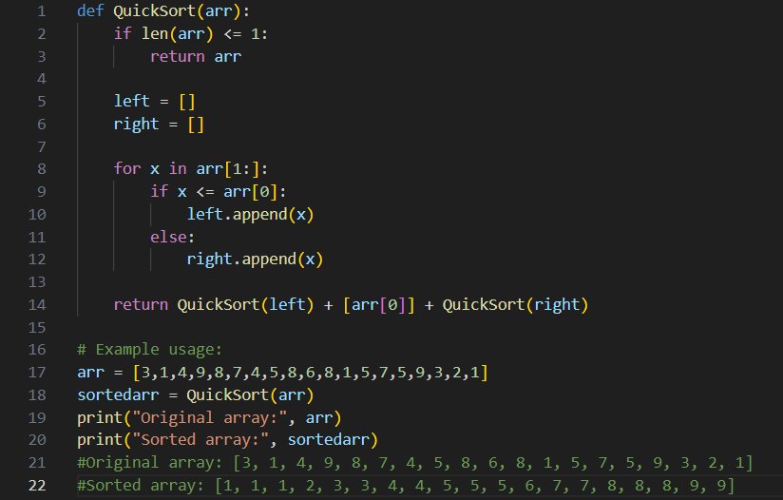
Quick Sort

Slide 7

Analytical Analysis
T(n)=$2T (\frac{n}{2}$) + n

Slide 8


Analytical Analysis
T(n)= $2T (\frac{n}{2}$) + n
$2T (\frac{n}{2}$) = $2\left(2T \left(\frac{n}{4}\right)+ \frac{n}{2} \right)$

Slide 9


Analytical Analysis
T(n)= $2T (\frac{n}{2}$) + n T(n) = $2\left(2T \left(\frac{n}{4}\right)+ \frac{n}{2} \right)$ + n
$2T (\frac{n}{2}$) = $2\left(2T \left(\frac{n}{4}\right)+ \frac{n}{2} \right)$

Slide 10


Analytical Analysis
T(n)= $2T (\frac{n}{2}$) + n T(n) = $2\left(2T \left(\frac{n}{4}\right)+ \frac{n}{2} \right)$ + n
T(n) = 4T $\left(\frac{n}{4}\right)$ + 2n + n
$2T (\frac{n}{2}$) =$2\left(2T \left(\frac{n}{4}\right)+ \frac{n}{2} \right)$

Slide 11


Analytical Analysis
T(n)= $2T (\frac{n}{2}$) + n T(n) = $2\left(2T \left(\frac{n}{4}\right)+ \frac{n}{2} \right)$ + n
T(n) = 4T $\left(\frac{n}{4}\right)$ + 2n + n
$2T (\frac{n}{2}$) =$2\left(2T \left(\frac{n}{4}\right)+ \frac{n}{2} \right)$
T $\left(\frac{n}{4}\right)$= 2T $\left(\frac{n}{8}\right)+ \left(\frac{n}{4}\right)$

Slide 12


Analytical Analysis
T(n)= $2T (\frac{n}{2}$) + n T(n) = $2\left(2T \left(\frac{n}{4}\right)+ \frac{n}{2} \right)$ + n
T(n) = 4T $\left(\frac{n}{4}\right)$ + 2n + n
T(n) = 4 (2T $\left(\frac{n}{8}\right)+ \left(\frac{n}{4}\right)$) + 2n + n
$2T (\frac{n}{2}$) =$2\left(2T \left(\frac{n}{4}\right)+ \frac{n}{2} \right)$
T $\left(\frac{n}{4}\right)$= 2T $\left(\frac{n}{8}\right)+ \left(\frac{n}{4}\right)$
We Found Pattern!!
Then Generalize

Slide 13


Analytical Analysis
T(n)= $2T (\frac{n}{2}$) + n T(n) = $2\left(2T \left(\frac{n}{4}\right)+ \frac{n}{2} \right)$ + n
T(n) = 4T $\left(\frac{n}{4}\right)$ + 2n + n
T(n) = 4 (2T $\left(\frac{n}{8}\right)+ \left(\frac{n}{4}\right)$) + 2n + n
Lets Simplify First:
T(n) = 8 T $\left(\frac{n}{8}\right)+4n+2n+n$
$2T (\frac{n}{2}$) =$2\left(2T \left(\frac{n}{4}\right)+ \frac{n}{2} \right)$
T $\left(\frac{n}{4}\right)$= 2T $\left(\frac{n}{8}\right)+ \left(\frac{n}{4}\right)$
We Found Pattern!!
Then Generalize

Slide 14

Analytical Analysis
T(n)= $2T (\frac{n}{2}$) + n T(n) = $2\left(2T \left(\frac{n}{4}\right)+ \frac{n}{2} \right)$ + n
T(n) = 4T $\left(\frac{n}{4}\right)$ + 2n + n
T(n) = 4 (2T $\left(\frac{n}{8}\right)+ \left(\frac{n}{4}\right)$) + 2n + n
Lets Simplify First:
T(n) = 8 T $\left(\frac{n}{8}\right)+4n+2n+n$
In general, after k iterations we get:
T(n) = $2^{k} T(\frac{n}{2^{k}})$ + kn
$2T (\frac{n}{2}$) =$2\left(2T \left(\frac{n}{4}\right)+ \frac{n}{2} \right)$
T $\left(\frac{n}{4}\right)$= 2T $\left(\frac{n}{8}\right)+ \left(\frac{n}{4}\right)$
We Found Pattern!!
Then Generalize

Slide 15

Cont. Analytical Analysis
T(n) = $2^{k} T(\frac{n}{2^{k}})$ + kn
Now when $\frac{n}{2^{k}}$ = 1 (reaching the base case), we have k=$\log_{2}$n. Substituting this back in, we get:
T(n) = nT(1) + $\log_{2}$n * n
Since T(1) is a constant, we can simplify this to:
T(n) = O (n log n)
So, the overall time complexity of QuickSort is O (n log n) on average and in the best case.

Slide 16
Lets Play a Game!!!

Slide 17
Unsorted Array
3
8
6
10
1
2
1

Slide 18
Pivot
3
8
6
10
1
2
1

Slide 19
Right Array
Pivot
3
Left Array
8
6
10
1
2
1

Slide 20
Right Array
8
Pivot
3
Left Array
- Are you <= 3?
= No.
- Move to right array
8
6
10
1
2
1

Slide 21
Right Array
8
6
Pivot
3
Left Array
- Are you <= 3?
= No.
- Move to right array
8
6
10
1
2
1

Slide 22
Right Array
8
6
10
Pivot
3
Left Array
- Are you <= 3?
= No.
- Move to right array
8
6
10
1
2
1

Slide 23
Right Array
8
6
10
Pivot
3
Left Array
1
- Are you <= 3?
= Yes.
- Move to left array
8
6
10
1
2
1

Slide 24
Right Array
8
6
10
Pivot
3
Left Array
1
2
- Are you <= 3?
= Yes.
- Move to left array
8
6
10
1
2
1

Slide 25
Right Array
8
6
10
Pivot
3
Left Array
1
2
1
- Are you <= 3?
= Yes.
- Move to left array
8
6
10
1
2
1

Slide 26
Sorting…
Pivot
3
Sorting…
1
2
1
8
6
10

Slide 27
Sorting…
Pivot
1
2
1
Waiting…
8
6
10

Slide 28
Sorting…
Pivot
2
1
1
Waiting…
8
6
10

Slide 29
Sorting…
Pivot
1
2
1
Waiting…
8
6
10

Slide 30
Sorting…
Pivot
1
2
1
Waiting…
8
6
10

Slide 31
Sorted!!!
Pivot
1
1
2
Starting…
8
6
10

Slide 32
Sorted!!!
Sorting…
8
6
10
Pivot
1
1
2

Slide 33
Sorted!!!
Sorting…
6
10
Pivot
8
1
1
2

Slide 34
Sorted!!!
Sorting…
6
10
Pivot
8
Already Sorted. Nothing Happens
1
1
2

Slide 35
Sorted!!!
Sorting…
6
10
Pivot
8
1
1
2

Slide 36
Sorted…
Sorted!!!
6
8
10
Pivot
1
1
2

Slide 37
Sorted!!!
Pivot
3
Sorted!!!
1
1
2
6
8
10

Slide 38
Inserting the first Pivot into the Middle of the array…
Pivot
3
1
1
2
6
8
10

Slide 39
1
1
2
3
6
8
10

Slide 40
Before
3
8
6
10
1
2
1
After
1
1
2
3
6
8
10

Slide 41
The End.

Slide 42
CONCLUSION
Divide and Conquer is like a smart way of solving big problems by breaking them into smaller, easier parts. It helps computers work faster, makes problem-solving simpler, and is used in many important tasks.

Slide 43

THANKS!
Do you have any questions?
mohamed.hussein20@msa.edu.eg
My Portfolio: bit.ly/47uONy4

